Slide 1
Server-side Scripting
Powering the webs favourite services

Slide 2
Server-side scripting for web based applications
Learning Intentions
Understand the relationship between the browser and the web server
Understand how files are requested from a web server, and how a server-side scripting language makes the contents of the pages dynamic
Understand the GET method of sending an item of data with a resource location
Understand how a web server can use a server-side scripting language to interact with a database to retrieve information
Success Criteria
I am able to explain how a web server responds to a request from a browser, and how the browser uses the HTML data
I can explain how a web server dynamically generates a page using a server-side script
I can explain how parameter can be passed in a GET request to send extra data between the browser and the HTTP server
I can explain how a database can be used to store information that appears on a web page

Slide 3
Example Website
We’re going to simulate what happens when a user interacts with the following sample website.
index.html
page2.html
check.php
sale.php
item.php
Notes:
Demonstrate moving between the different pages

Slide 4
How a URL gets turned into a request
URL: http://www.theguardian.com/uk
GET /uk/ HTTP/1.1
Host: www.theguardian.com
The HTTP server will fetch a default html file if no file is specified. This will usually be some variation of index.html

Slide 5
Setting up your group
Table
Browser
Request slips
Blank browser window
Coordinator
Internet
Standing between tables
Task 1 to 5 Diagrams
HTTP Server
Scripting Engine
Database server
All regular html, .php and media files.
PHP option sheets
Database query slips
Database table
Query result options

Slide 6
Task one – static web page
When a static HTML page is requested, the HTTP server will locate the file and send it back
User types in url
http://testserver.com/index.html
into the browser

Slide 7




Task one- static web page
Web Browser
Internet
HTTP Server
User types in http://testserver.com/index.html
Request
Get /index.html
Host testserver.com
Request
Get /index.html
Host testserver.com
Create page request
Find server location
Locate index.html in http document store
Display rendered index.html webpage
Return Index.html file
Return Index.html file
Turn index.html description into final rendered page
Find user machine location

Slide 8
Task two– static web page with images
When a static HTML page is requested, the HTTP server will locate the file and send it back
When rendering the page, images may also need to be requested one by one using the IMG tag src as the location
User clicks on the click here to access our sale link
http://testserver.com/page2.html

Slide 9
Task two- static web page with images
Web Browser
Internet
HTTP Server
Request
Get /page2.html
Host testserver.com
Request
Get /page2.html
Host testserver.com
User clicks on link http://testserver.com/page2.html
Find server location
Locate index.html in http document store
Create page request
page2.html file
Index.html file
Find user machine location
Request
img/sale.png
Request
img/sale.png
Find server location
Create first image request
Locate img/sale.png in http document store
sale.png file
Find user machine location
sale.png file
Create second image request
Request
img/buynow.jpg
Request
Img/buynow.jpg
Display rendered page 2
Find server location
Locate img/buynow.jpg in http document store
Finish rendering final web page
Buynow.jpg file
Find user machine location
Buynow.jpg file

Slide 10
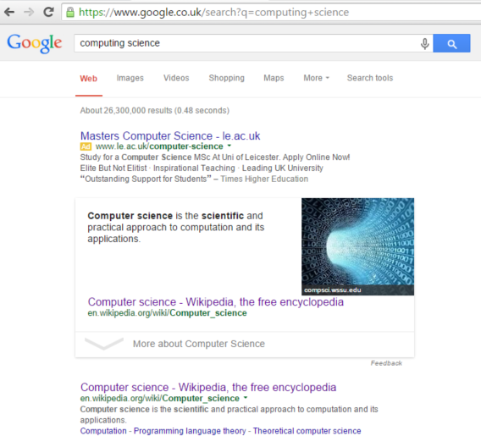

Passing extra information to a webserver
Example
Many situations where a static page isn’t enough
Need a way of passing information provided by the user to the webserver
Two methods
GET allows information to be added to the url
POST allows information to be sent separately with the url
Computing Science

Slide 11
How a URL with a parameter gets turned into a request
URL: http://www.google.co.uk/search
With parameter name q = computing science
GET /search?q=computing+science HTTP/1.1
Host: www.google.co.uk
Extra information the user adds by typing something in or interacting with the page gets added to the URL
Notes:
Dem

Slide 12
Task three – server-side script request
When the user types in information into a form on a webpage and clicks a button this information added to the request for the particular server-side scripted page.
The scripting engine will use the information from the user and the code in server-side scripted page to generate a new custom html page.
This newly generated page will be sent back to the user.
Request from form is for http://testserver.com/check.php
with secret code parameter ?code=MAGICDUCKS

Slide 13

Task three- server side script request
Web Browser
Internet
HTTP Server
Request
Get /check.php?code= MAGICDUCKS
Host testserver.com
Request
Get /check.php?code= MAGICDUCKS
Host testserver.com
User types in MAGICDUCKS then clicks submit
Create page request
Find server location
Locate check.php in document store
Return lets go to the secret sale page html
Return lets go to the secret sale page html
Display rendered lets go to the secret sale webpage
Turn secret sale html description into final webpage
Find user machine location
Add the return address the generated page should be sent to
Scripting Engine
Send check.php script with parameter code=MAGICDUCKS
Execute check.php script to decide which HTML page gets created. No access or lets go to the secret sale
Return Lets go to the secret sale page html

Slide 14
How database code in a server side script gets turned into a database query
What we want the database to do
SELECT * FROM products ORDER BY id
$sql = "SELECT * FROM products ORDER BY id";
$result = mysql_query($sql) or die("Error ".mysql_error($db));
Sending the query to the database

Slide 15
Task four – Server side script with database query
When a server side scripted file such as .php is requested, it may need some data from a database to help it create the html page.
It connects and sends a query to the database which will return a list of records back.
The database returns a set of records to the scripting engine that are used to help create the final page.
User clicks on secret sale link which requests http://testserver.com/sale.php

Slide 16

Task four – Server side script with database query
Web Browser
Internet
HTTP Server
Request
Get /sale.php
Host testserver.com
Request
Get /sale.php
Host testserver.com
User clicks on secret sale link
Create page request
Find server location
Locate sale.php in document store
Display rendered sale webpage
Turn sale html description into final webpage
Return sale page html
Return sale page html
Find user machine location
Add the return address the generated page should be sent to
Scripting Engine
Database Server
Connect and send Database query
SELECT * FROM products ORDER BY id
Send sale.php script
Execute sale.php script which needs item data from database
Search for all items in products table and put them in ascending order of id
Return all item records in ascending order of id
Return sales page html
Use item records to help create sales html page

Slide 17
Task five – Server side script with a parameter based database query
When a server side scripted file such as .php is requested, it may need some data from a database first.
The data it needs could depend on user input which will be passed as a parameter. This data is then used by the scripting engine to create a specific database query.
It connects and sends this query to the database which will return a list of records back to the scripting engine.
The data is used by the scripting engine to create the final html page.
User clicks on Rocking horse click for more information link which requests http://testserver.com/item.php?id=1

Slide 18
Task five – Server side script with a parameter based database query
Web Browser
Request
Get /item.php?id=1
Host testserver.com
Internet
HTTP Server
Request
Get /item.php?id=1
Host testserver.com
User clicks on Rocking horse find out more link
Find server location
Return rocking horse html page
Locate sale.php in document store
Create item.php?id=1 page request
Return rocking horse html
Find user machine location
Request
Get img/horse.jpg
Host testserver.com
Add the return address
Create img/horse.jpg request
Request
Get img/horse.jpg
Host testserver.com
Display rendered Rocking horse item webpage
Find server location
Turn rocking horse html into final page
Return horse.jpg file
Locate img/horse.jpg in document store
Find user machine location
Return horse.jpg file
Scripting Engine
Connect and send database query
SELECT * FROM products WHERE id = 1
Send item.php script with parameter id=1
Database Server
Execute item.php script which needs id=1 item from database
Return rocking horse html
Search for item record with id=1 in the products table
Return item record with id=1
Use record to create rocking horse html page

Slide 19
General Model
This can be used to help you remember how information may flow between different parts of a web based application.

Slide 20
Web Browser
Create page request
Combine html and other files to render final web page
Internet
Find server location
Find user machine location
HTTP Server
Locate file in http document store
Send to scripting engine for further processing
Request for static file
User types in URL, clicks on link or submits form
Request with server and resource
Request for server side script file
html, css, javascript, media or other file
Final rendered web page
html, css, javascript, media file
Fully processed html file
Scripting Engine
combine html fragments with results of php instructions to create complete html file
Database query
SELECT * FROM table
Database Server
Searches for matching records, or updates, deletes or amends information
Server side script file
Fully processed html file
Return result of query

